Slide 1
CASE B AGGREGATE PLANNING AT GREEN MILLS
IS 610 SEC 01 12531 - BUSINESS DATA ANALYSIS
(Dr. Ming Chen)
Team Members
Harshitha Manjunatha(029908526)
Ridhi Sethi(030711536)
Rashmi Shettigar(030238934)
Sarvesh Sankpal(030704802)

Slide 2
Case Study – Aggregate planning at Green Mills
The aim is to develop a minimum total cost aggregate plan.
Green Mills Inc. tried to integrate a backward vertical integration strategy.
We use different aggregate planning strategies to compute the annual cost plan.
Based on each of the conclusions, we conclude the optimal strategy for calculating the minimum total cost.

Slide 3
Backward vertical integration strategy
Involves a firm moving back along the value chain and entering a supplier’s business.
Green Mills Inc. tried to integrate a backward vertical integration strategy to avoid giving suppliers too much power over the business

Slide 4
Aggregate Planning
Process of developing, analyzing, and maintaining a preliminary, approximate schedule of the overall operations of an organization.
Contains targeted sales forecasts, production levels, inventory levels and customer backlogs.

Slide 5
Why do organizations need aggregate planning?
Faster Implementation of curated plans.
Obtaining financial objectives by lowering overall variable costs and improving results.
Focuses on Client satisfaction and meeting demands.
Making the best use of the available production capacity.
Provide customer delight by matching demand and reducing customer wait time.
Reduce inventory stocking investment.
It can help synchronized flow throughout the supply chain it affects costs, equipment utilization, employment levels and customer satisfaction.

Slide 6
Advantages of aggregate planning
Minimize Staffing Fluctuations
Increase Production Rates
Accommodate Changes

Slide 7
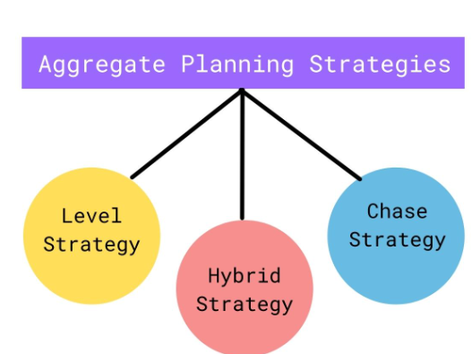

Slide 8
Chase Strategy
As the name implies, this strategy involves chasing demand.
The company only produces when there is a demand for it.
A chase strategy implies matching demand and capacity period by period which can be achieved by hiring or firing employees.

Slide 9
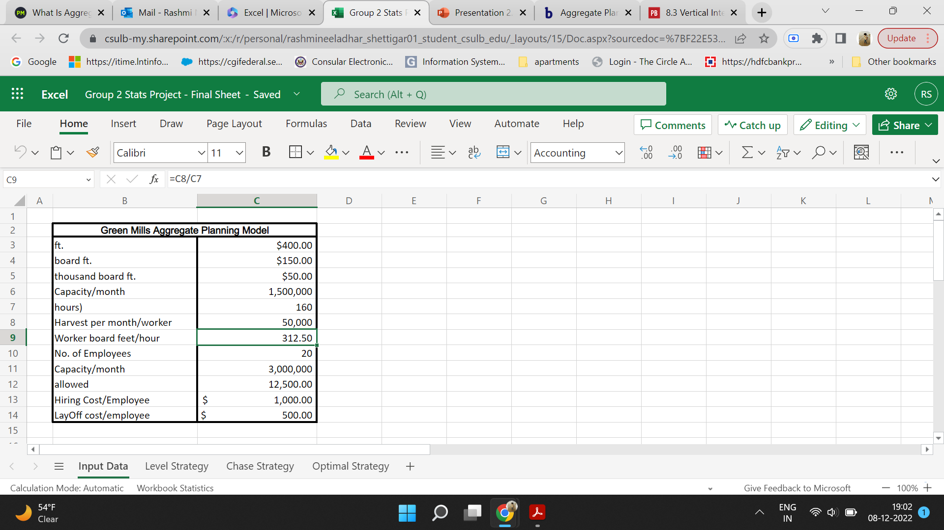
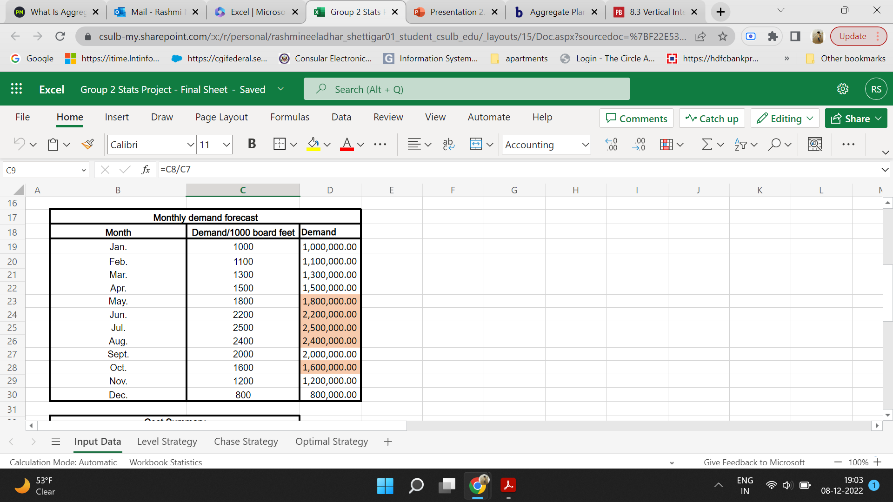
Input data

Slide 10
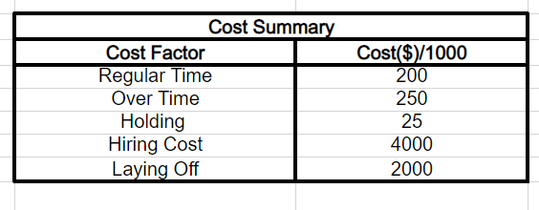
Input data

Slide 11
Chase Strategy
The use of a chase strategy requires that a company have the ability to readily change its output level, which means that it must be able to readily change its capacity.
Ex: When you go to a restaurant for food and place an order the staff will "chase the demand."
In this case study, overtime and spot market is not considered in account.
Spot market: financial instruments are traded for immediate delivery, cash for commodities are also paid at the instant.

Slide 12
Chase Strategy
Advantages:
Lower inventory levels
Flexibility to meet demands
Saves time
Disadvantages:
Hiring cost
Laying off cost
Longer lead times from order to delivery

Slide 13
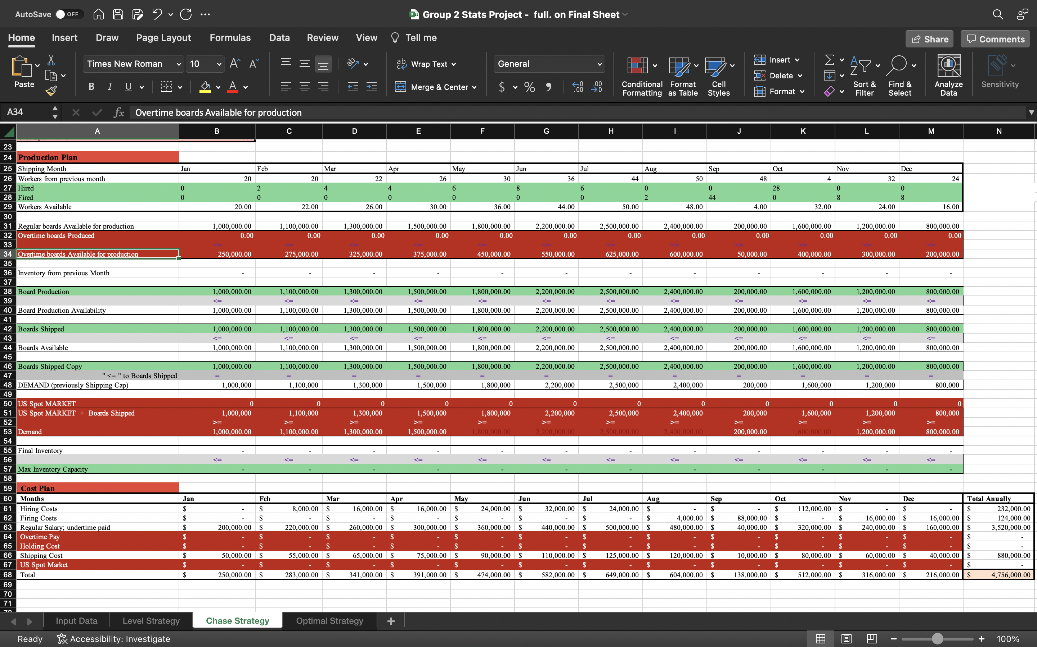
Cost Plan for Green Mill Inc Using Chase strategy

Slide 14
Level Strategy
An aggregate planning strategy's goal is to maintain the production rate and workforce level.
This necessitates accurate demand forecasting to determine whether production levels should be increased or decreased as customer demands grow and shrink.
It has stable workforce, no hiring/firing costs.

Slide 15
Benefits:
It enables a firm to maintain a constant production level and still meet demand.
This approach is more convenient to the employee since working conditions remain constant .
There is no hiring and firing costs,

Slide 16
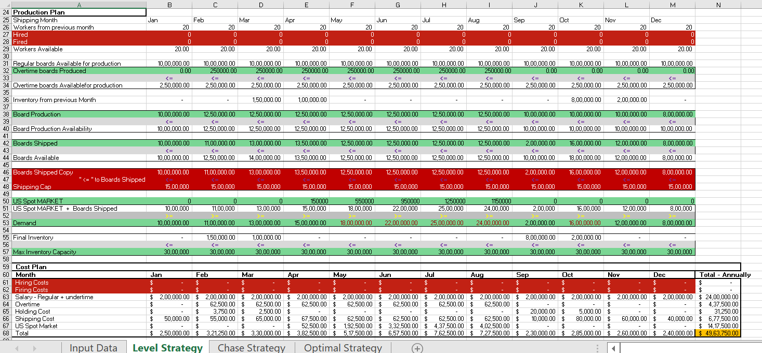
Cost Plan for Green Mill Inc Using Level Strategy

Slide 17
Hybrid Strategy
Hybrid strategy is an aggregate planning strategy with a combination of both level and chase strategies.
In the chase strategy, we hire and layoff employees depending on the demand, and in level strategy, we meet the demand by increasing the work hours.
We can use a hybrid strategy in seasonal industries, new product launches, and changing market conditions.

Slide 18
Hybrid Strategy
Benefits:-
It can help to reduce cost
Avoid storages
Maintaining a predictable production schedule.

Slide 19
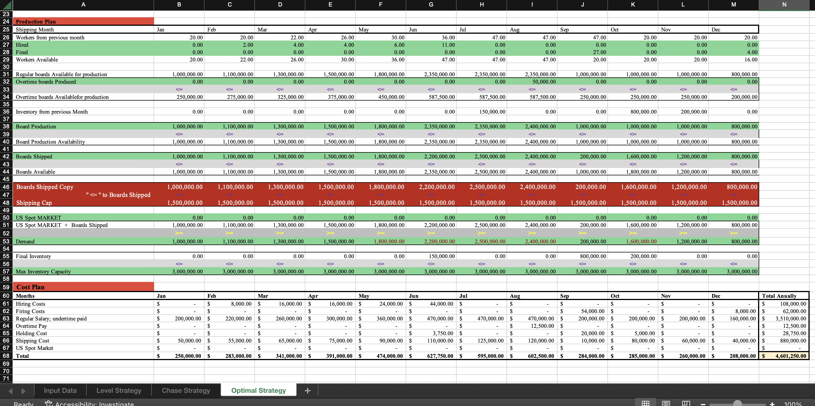
Cost plan for green mills INC using hybrid strategy

Slide 20
Conclusion
The total cost incurred for the whole year in level planning is $4,963,750.00
The total cost incurred for the whole year in chase planning is $4,756,000.00
The total cost incurred for the whole year in hybrid planning is $4,601,250.00
From this analysis, we conclude that Hybrid solution is the optimal solution which has the least cost.

